Slide 1
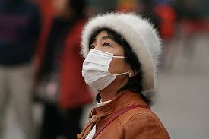
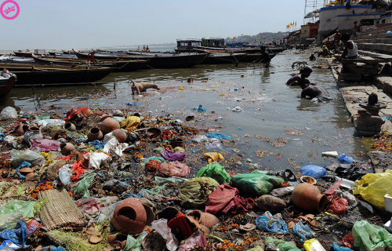
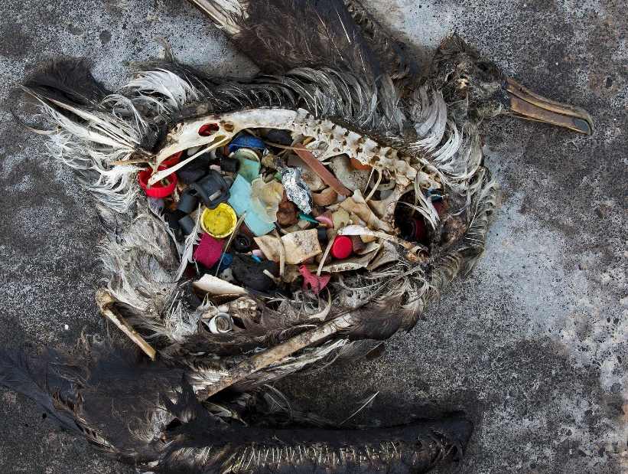
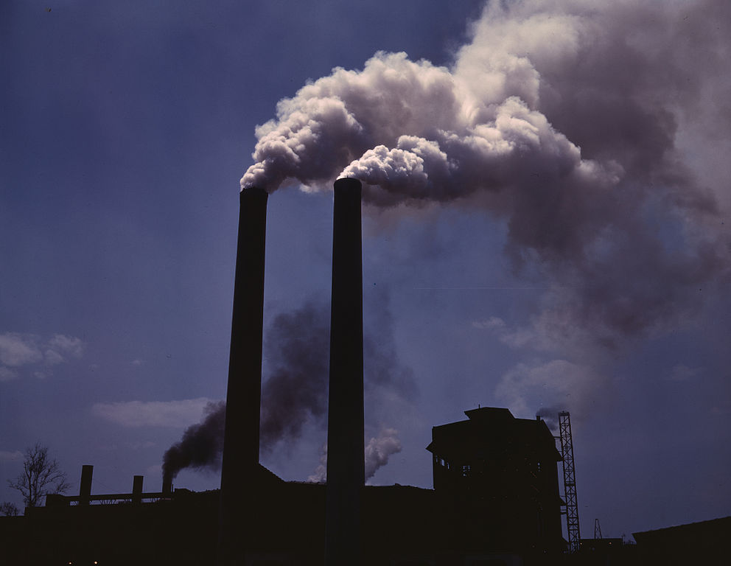
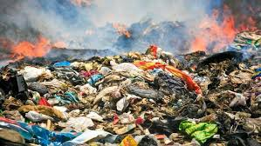
Environmental Pollution
Pictures
Air pollution is chocking the South Asian region
Picture from the Ganges
Industrial emission contributes heavily to air pollution
Plastic waste disposal/management is a growing issue all over the globe
A dead albatross in midway island

Slide 2
Outline
Types of Pollution
Air Pollution
Water Pollution
Noise Pollution
Legal and regulatory frameworks for abating environmental pollution
Land Pollution/land degradation
Desertification
Countering Desertification

Slide 3
‘Unwanted change in the environment caused by the introduction of harmful materials or production of harmful conditions (sound, cold etc.)’¹
As per a Cornell university study, 40% of mortality over the globe are caused by water, air and soil pollution
Two types of sources of Pollution
Point source: identifiable sources (Eg: a factory)
Non-point source: Difficult to identify since pollutants are dispersed (Eg: Run-off from fields contaminated with pesticides)
Notes:
Reference: 1. Botkin and Keller (2012) Environmental Science, Eight edition, Wiley publishers, New Delhi

Slide 4
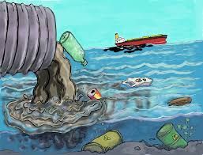
Types of Pollution
Air Pollution
Water Pollution
Noise Pollution
Land/Soil Degradation
Pencil sketch depicting water pollution

Slide 5
Air Pollution
Air pollution is most harmful since air is the fastest moving fluid medium in the environment.
Air pollution kills More than 5.5 million people all over the globe each year, as per an American Association for the Advancement of Science (AAAS) report 2016
1.2 million deaths per year in India due to air pollution, as per Greenpeace,2017

Slide 6
Major Pollutants and their sources and impacts
Sulphur Dioxide
Important Sources: Automobiles, factories and cooking
Major Impacts: Cause health hazard like nausea and head ache on exposure, Effect plant growth pattern by damaging foliage, kills lichens and bryophytes; responsible for acid rain
Oxides of Nitrogen
Important Sources: Automobiles, Factories
Major Impacts: Create ‘Smog’; aggravate respiratory illness; kills plants and aquatic life; damage monuments and structures, since it is responsible for acid rain.

Slide 7
Sources
Ozone (in the troposphere)
Important Sources: Factories, Automobile
Major Impacts: foliage damage and damage of flora; create smog, various health hazards, destroy rubber fabrics and paints
Carbon Monoxide
Important Sources: Automobiles, cigarettes
Major Impacts: extreme health hazards

Slide 8
Sources
Fluoride compounds
Important sources: Industries (glass, brick etc), refrigerants
Major Impacts: contaminate with fresh water, kill plants, effect cattle
Chlorofluorocarbon is the major cause agent for ozone depletion

Slide 9
Sources
Suspended Particulate Matter (SPM)
Tiny (0.1-25 ηm) solid/liquid matter
Sources: Factories, Automobile, agriculture burning, burning of plastic, mining
Impacts: health hazards (Byproduct of burning plastic, led cadmium and dioxins may cause cancer); acid rain; smog; killing plants by interfering transpiration and photosynthesis by the accumulation on leaf surface; affect drinking water sources

Slide 10
Water Pollution
Refers to degradation of water quality
Water is polluted more easily than air
Pollutants from land and air normally ends up polluting water bodies
Pollutants when seep to ground water result in ground water contamination
Agricultural, industrial, and domestic sectors consume more than one-third of Earth’s accessible renewable freshwater

Slide 11
Impacts
“Today, 1.8 billion people consume contaminated (with faeces) water, putting them at risk of contracting waterborne infections; waterborne infections account for 80% of all infectious diseases
Eutrophication leads to huge economic loss; in England and Wales $105-160 million and in US $2.2 billion every year*
The Indian cities Uncontrolled urbanization in Indian cities
Notes:
*Pretty, J.N.; Mason, C.F.; Nedwell, D.B.; Hine, R.E.; Leaf, S.; Dils, R. Environmental costs of freshwater eutrophication in England and Wales. Environ. Sci. Technol. 2003, 32, 201–208
Dodds, W.K.; Bouska, W.W.; Eitzman, J.L.; Pilger, T.J.; Pitts, K.L.; Riley, A.J.; Schloesser, J.T.; Thornbrugh, D.J. Eutrophication of U.S. freshwaters: Analysis of potential economic damages. Environ. Sci. Technol. 2009, 43, 12–19.

Slide 12
Sources of Water Pollution
Urban runoff (oil, chemicals, organic matter)
Agriculture runoff (oil, metals, chemicals)
Industrial runoff (chemicals, radioactive materials, organic matters, sediments (mines))
Leaks from storage tanks/pipelines (gasoline, oil etc.)
Accidental spill of chemicals (oil, chemicals etc.)
Salt water intrusion (low lying areas)
Seepage from septic system

Slide 13
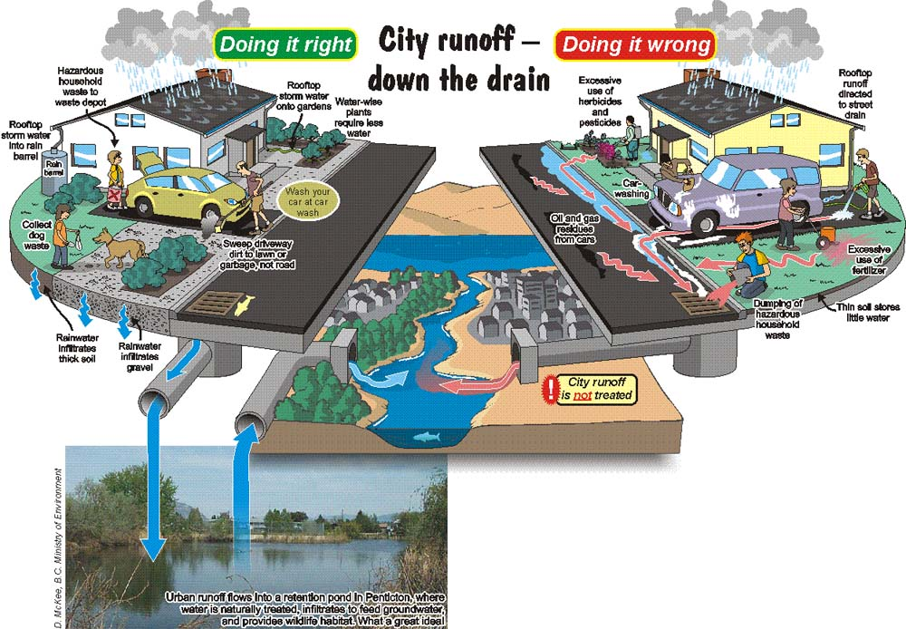
© http://www.cgenarchive.org/okanagan-basin-use-outdoors.html

Slide 14
Biological Oxygen Demand
The amount of oxygen required for biochemical decomposition of organic materials in the water is Biological/biochemical Oxygen Demand (BOD)
An indicator of water quality
when BOD increases Dissolved Oxygen (DO) decreases.

Slide 15
Noise Pollution
Can be a component of Air pollution
Noise is sound that causes discomfort
Safe limit → 45 Db
Noise→ above 75Db
Above 150 Db→ cause instantaneous deafness
However, safe intensity of sound in human even detrimental to many animals and birds
*Sound is measured using decibel (Db)

Slide 16
Sources
Automobiles
Factories
Workshops
Loud speakers
Crackers

Slide 17
Legal and regulatory frameworks for controlling Environmental Pollution
Publication of Silent Spring by Rachel Carson in 1962 brought substantial transformation in environmental consciousness over the globe, thereafter a handful of agencies worldwide formed legal frameworks for protecting environment from pollutions, Eg:
United States Environmental Protection Agency (EPA-1970)
United Nations Environment Programme (UNEP-1972)
Ministry of Environment, Forest and Climate Change (MoEFCC-1985 India)

Slide 18
Legal and regulatory frameworks for controlling Environmental Pollution
Central Pollution Control Board (CPCB) of India
Established in 1974 under MoEFCC; there are 7 zonal office and state PCBs
Acts entrusted under the CPCB power:
The Water (Prevention and Control of Pollution) Act, 1974
The Air (Prevention and Control of Pollution) Act, 1981
The Noise Pollution (Regulation And Control) Rules, 2000

Slide 19
Land Pollution/land degradation
The process by which the value of the biophysical environment is affected by one or more combination of human-induced processes acting upon the land.
It is estimated that up to 40% of the world's agricultural land is seriously degraded.

Slide 20
Causes of Land Degradation
Land clearance, such as clear-cutting and deforestation
Agricultural depletion of soil nutrients through poor farming practices
Livestock including overgrazing
Irrigation and overdrafting
Urban sprawl and commercial development
Land pollution including industrial waste
Vehicle off-roading
Quarrying of stone, sand, ore and minerals

Slide 21
Effects of Land Degradation
The overall outcome of land degradation is a substantial reduction in the productivity of the land. The processes involved in degradation are:
Accelerated soil erosion by wind and water
Soil acidification or alkalinisation & Salination
Destruction of soil structure including loss of organic matter

Slide 22
Land Degradation—Prime Examples
Overcutting of vegetation for timber and fuelwood. E.g. Iran.
Overgrazing—decrease in the vegetation—wind and water erosion. E.g. Afghanistan.
Agricultural activities (shifting cultivation, absence of soil conservation measures, fertilizer use, faulty planning or management of irrigation) E.g. Bangladesh.
High population density (land shortage)—excessive pressure on land for above uses. E.g Pakistan.

Slide 23
Food Resources
Starvation and malnutrition are rampant in Africa, Asia, Latin America
Regions of dense population and poor economies most affected
Surplus food in developed world; used for livestock. In the US Midwest, farmers are paid to leave land fallow!
Land use for cash crop production
Presently, proper land management and equitable distribution may be required
Unless we take drastic steps to reduce possible, more starvation is inevitable in the future.

Slide 24
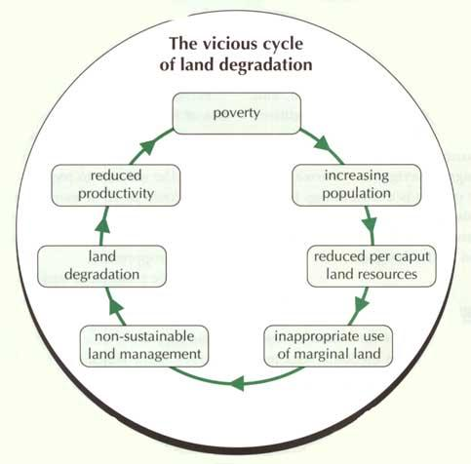
PC: http://www.fao.org/

Slide 25
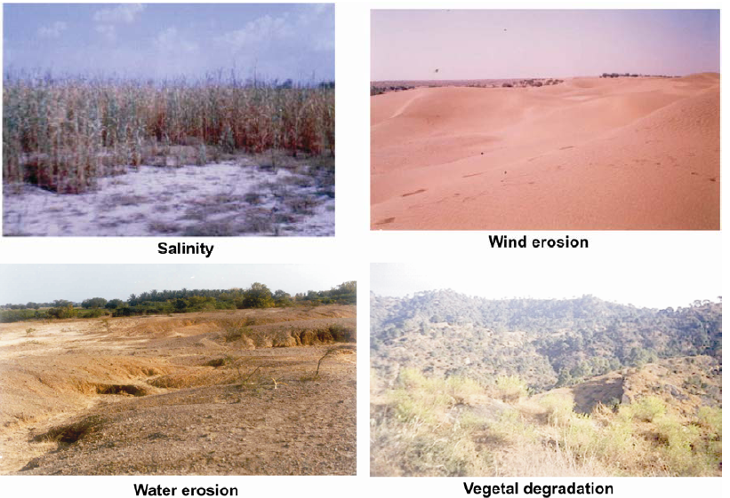
Land Degradation—India

Slide 26
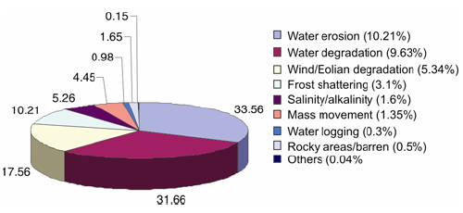
Land Degradation—India
By Process

Slide 27
Remedial Measures
Reduce population and urban sprawl
Reduce industrialization or mining of environmentally sensitive areas.
Develop and strictly enforce pollution control standards
Active steps to combat global warming
Implement watershed development strategies as alternatives to mega dams
Waste: Reduce, Reuse, Recycle

Slide 28
Desertification
Desertification is the degradation of land in arid, semi-arid, and dry sub-humid areas resulting from various climatic variations, but primarily resulting from human activities.
Effect of desertification
Loss of Biodiversity
Loss of productive capacity
Loss of water availability
Famines, droughts, more degradation, reduced rainfall

Slide 29
Causes of Desertification
Deforestation
Burning
Overgrazing: animal hooves destroying new growth, uprooting grass while eating, eating of other plant species
Over agriculture: loss of fertility erosion, nutrient leaching.
Salinization: due to excess watering with salt containing water
Global climate change

Slide 30
Global Effects
US Embassy Reports—satellite images
2 deserts in N. Central Asia merging
24,000 villages overrun by sand
In 2000, 2,240 sq. km/yr. lost to deserts
Afganistan, 100 villages buried under sand. 15 m high sand dunes block roads.
Iran 124 villages buried
Nigeria 2000 sq. km/yr lost to deserts
Mexico 700,000 men forced off the land due to land degradation
India 328 million hectares of land affected.

Slide 31
Countering Desertification
Windbreaks
Sand fences, stone fences, tall trees/shrubs
Prevent evapotranspiration, sand deposition and soil erosion
Improve Soil fertility: hardy leguminous plants
Water harvesting and storage; Watershed management
Percolation tanks, contour bunding and planting,
stone stacks at plant base to collect dew
Storage tanks; Check dams and canals
Cooking Fuel: firewood plantation, solar cooking
Sustainable farming and livestock rearing:
crop rotation, crop choice, fallow periods, limit livestock, prevent overgrazing

Slide 32
United Nations Convention to Combat Desertification (UNCCD)
Established in 1994; a legally binding international agreement linking environment and development
“…to forge a global partnership to reverse and prevent desertification/land degradation and to mitigate the effects of drought in affected areas in order to support poverty reduction and environmental sustainability”
Focus specifically the drylands in arid, semi-arid and dry sub-humid areas over the globe

